Slide 1
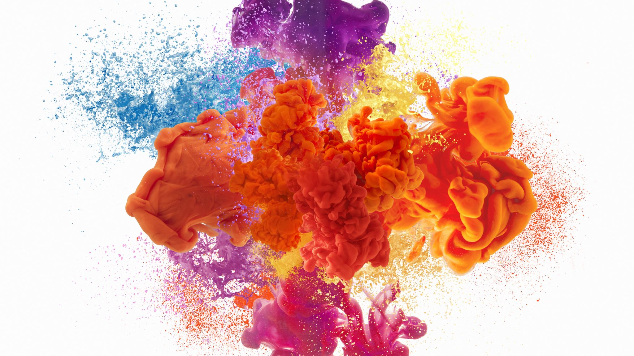
Similar Traits in Expensive Beijing Houses

Slide 2
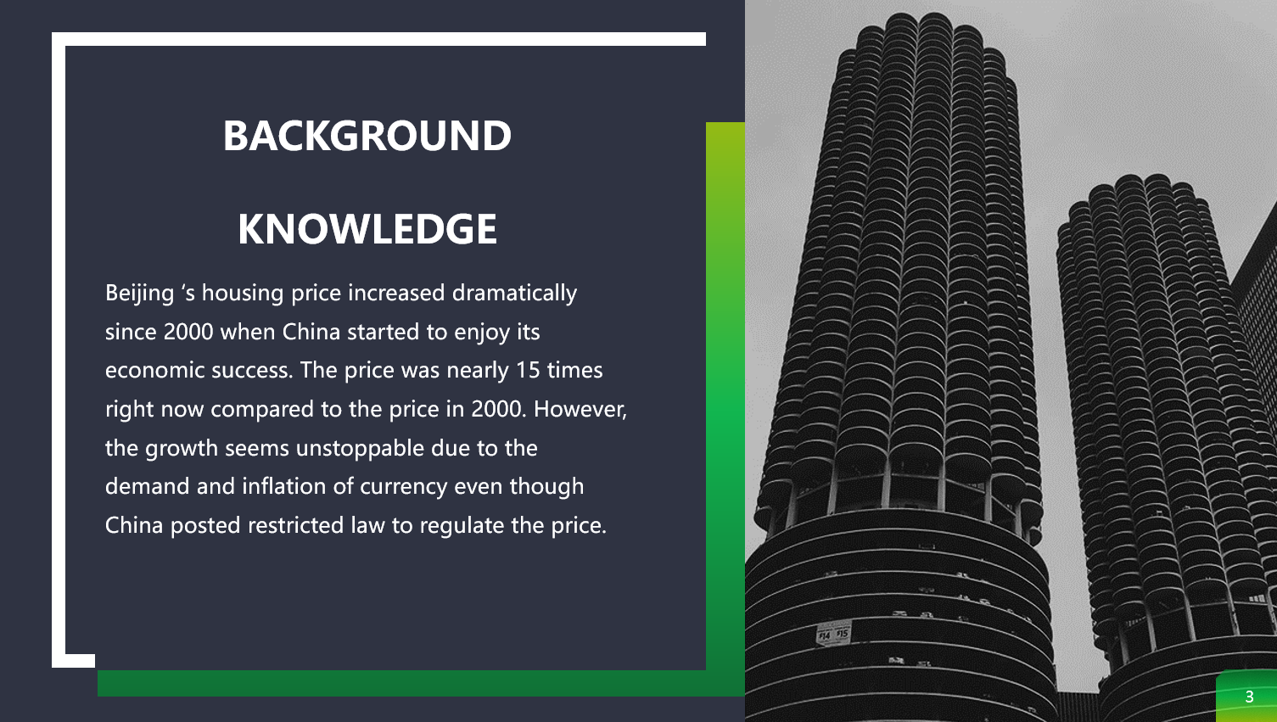

Slide 3
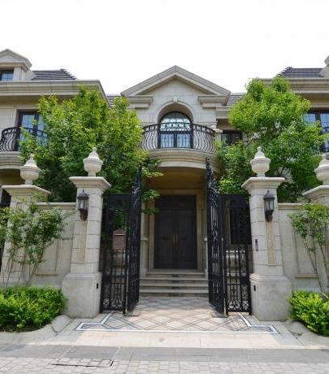
What are some common traits in the expensive house?
Looks like a mansion?
Big?
More likely to located in a city?
How well did these common traits influence the housing price?

Slide 4
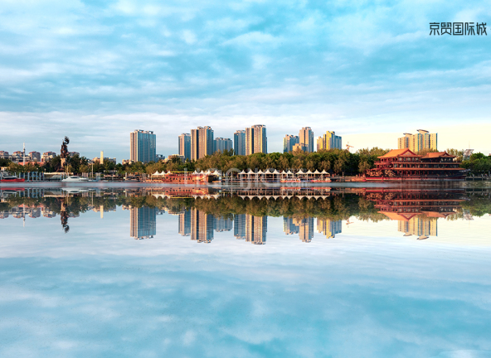
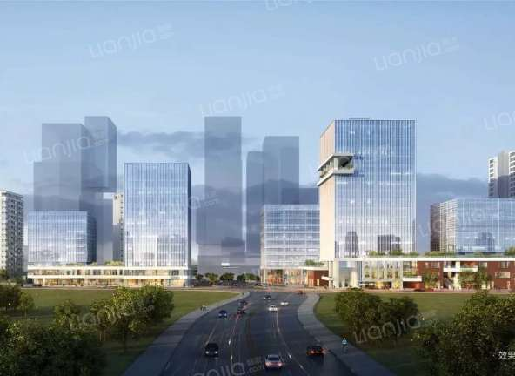
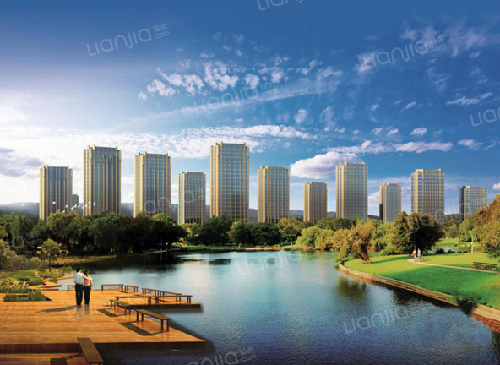
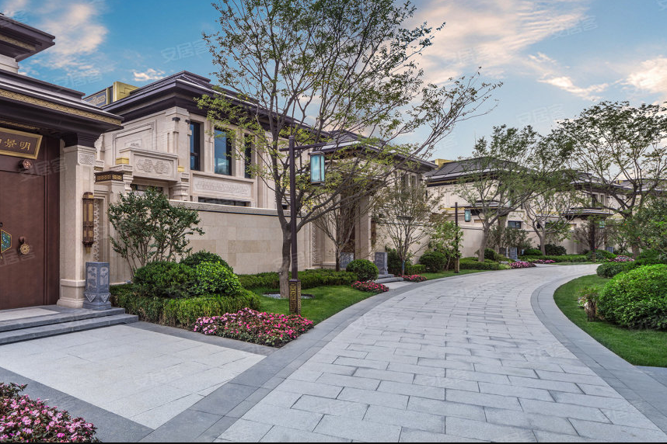
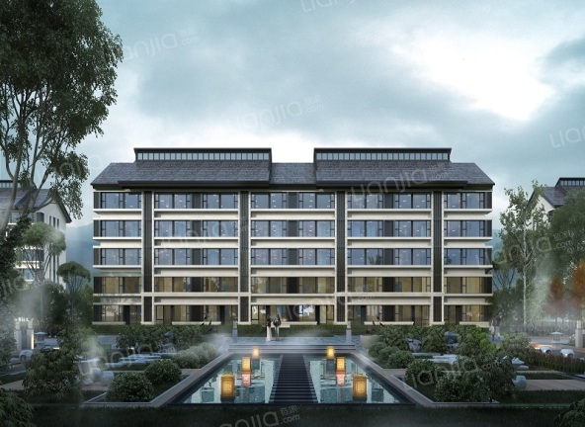
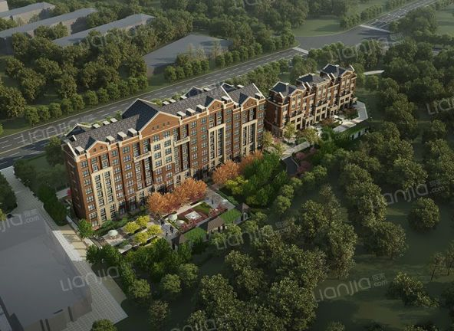
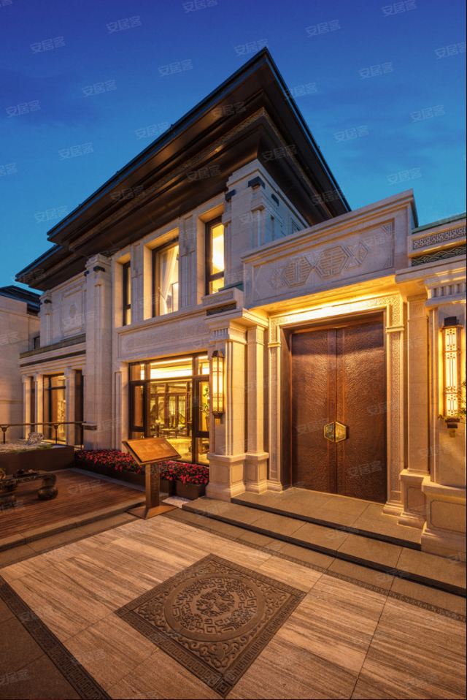
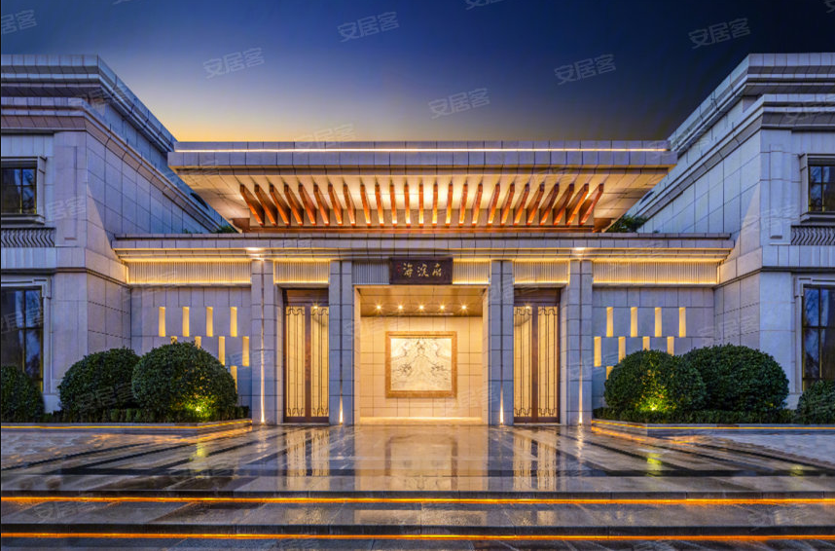
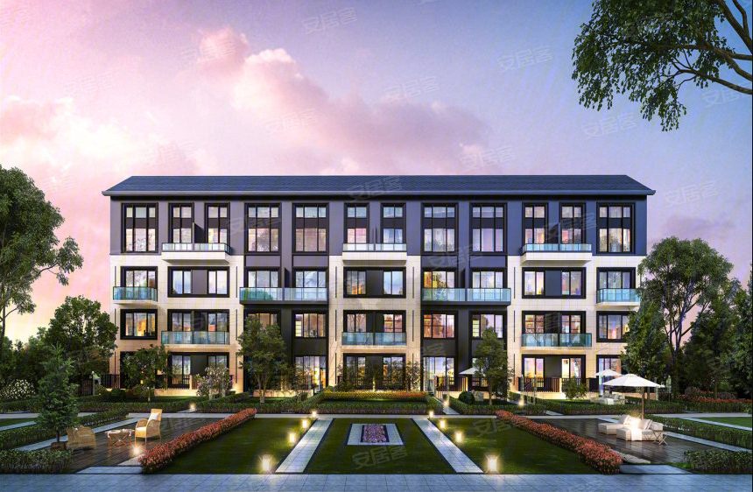
Picture of 9 expensive Beijing House ranged from $2 million to $3 million
Source: https://bj.fang.lianjia.com/loupan/bp1000ep9999/

Slide 5
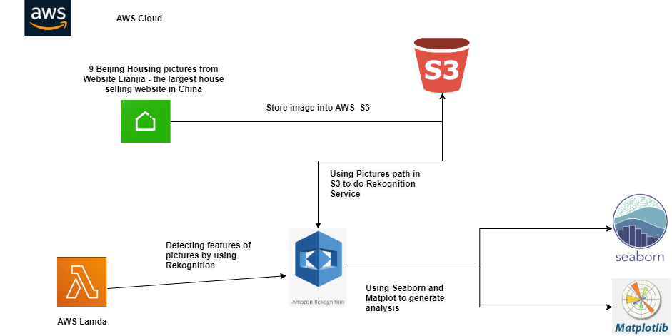

Slide 6
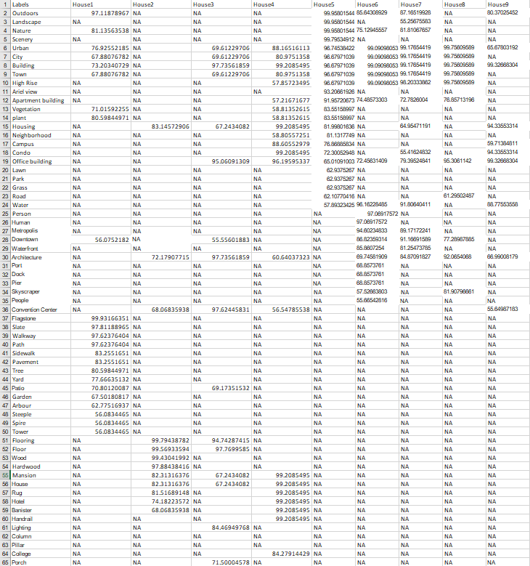

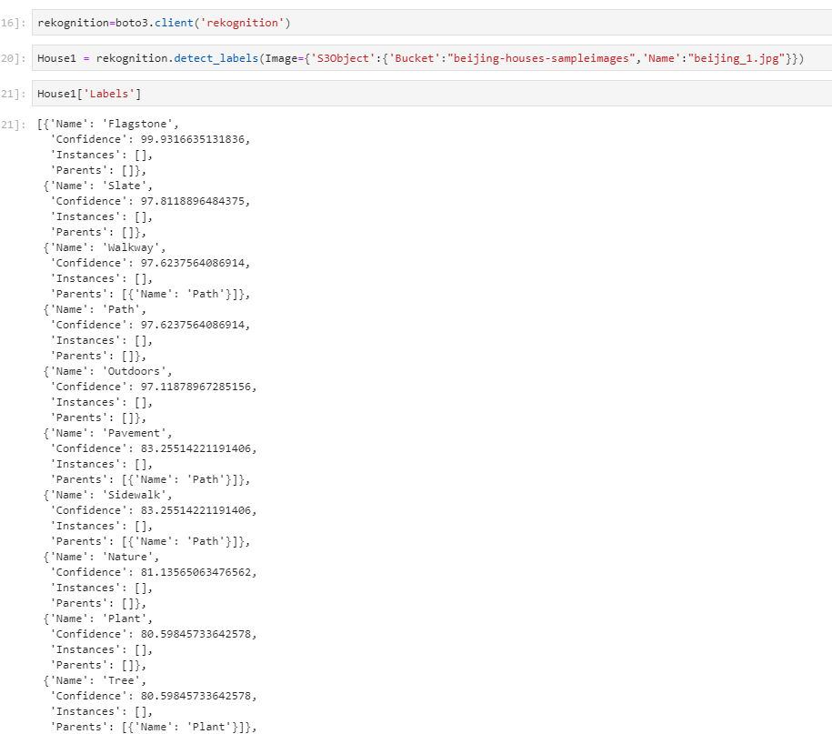
Output of Rekognition Data

Slide 7
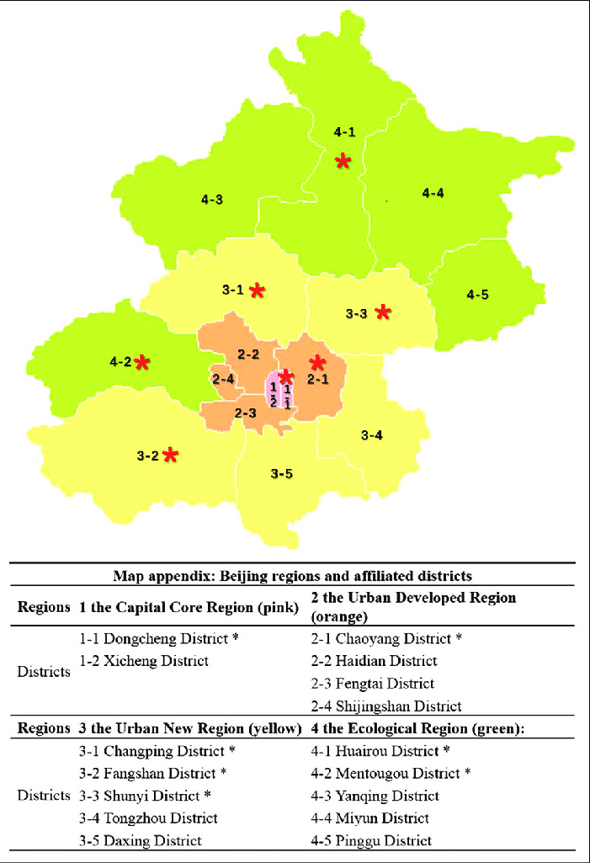
Big direction
Check if city confidence level was authentic compared to each house located

Slide 8
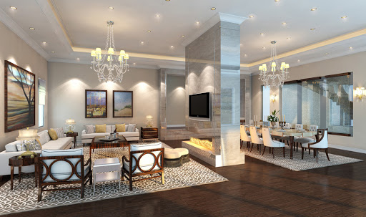
Big Direction
Check the relationship between confidence level of a city and its housing price

Slide 9
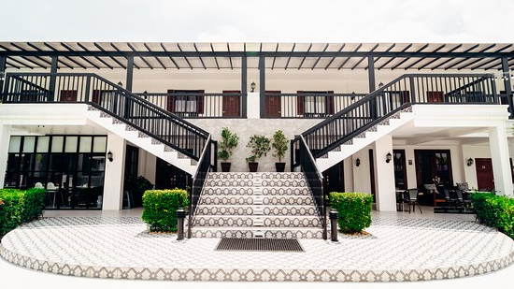
Big Direction
Check if confidence of mansion label variable is positively related to the price of Beijing House

